Slide 1


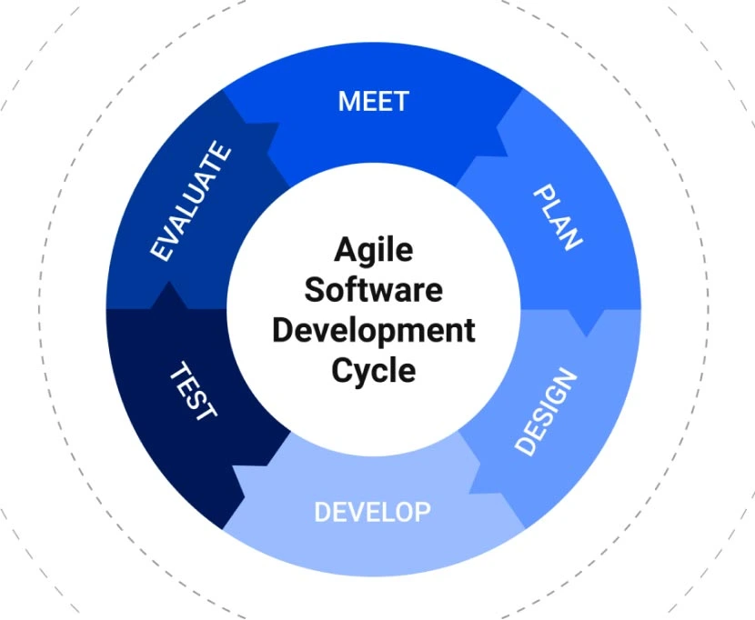
Agile Presentation
Student Name: Robert Clough
Course: CS-250 Software Development Lifecycle

Slide 2
What is Agile?
The meaning of the word agile is the process of being quick and easy. Agile is integrated into the software development model through the Scrum methodology.
The Scrum Methodology in the Agile Software Development Lifecycle (SDLC) consists of multiple Agile Scrum teams working independently towards the same goal.

Slide 3
Agile Scrum Roles & Responsibilities
Product Owner (PO) – Liaison between the stakeholder and team. The Product Owner defines the product, the stakeholder’s expectations and outlines the projects priorities.
Scrum Master (SM) – Helps to facilitate the agile Scrum team through sprint planning, daily status meetings, and reviews of the necessary improvements needed to achieve the goal.
Development Team (DT) – develops all the code based on the requirements from the Product Owner and Scrum Master.
Tester – Completes routine testing throughout the development of the project.

Slide 4
Agile Phases
There are 7 phases of the Software Development Lifecycle (SDLC):
1. Planning – The planning phase allows the team to ask, “What do we want?” and determine what is to be accomplished. The importance of the planning phase is that it covers the entire scope and total requirements for the project. The planning stage will also include the estimated cost, required manpower, and estimated completion time.
2. Requirement Analysis – This step is about gathering the maximum information from the client regarding their requirements for the product. Once the information is extracted from the client, the development team will analyze it, formulate a plan of attack based on the given information, and get everybody to understand every detail of this assignment.
3. Design – In this step, the development teams decide if the prepared software meets the base requirements for the end user and if possible, for the customer. This is based on financials, practicality, and technology available to them. This is also the step where the program languages like Java, C++, or Oracle are chosen.

Slide 5
Agile Phases Cont’d
4. Development – This stage is very simple and complex at the same time. Implementation step where are not taking the design agreed upon and translating it into a computer-legible language, the developers will form teams able to focus on specific tasks that will eventually fold into each other to make the program
5. Testing – In the testing stage, the software have been mostly built, and then it gets tested, checking mainly for functionality the testers will run through the software to find any bugs or area that don't work as intended per the design specifications.
6. Implementation – This is where the software is released to the client, after some training so that the client knows how to operate the software, another round of testing will be done during this time probably while the client is learning how to use the software, to ensure the program works.
7. Maintenance – The final phase is the trickiest as it generally has the most chaotic issues and the shortest working window. Based on the issue, they could range from minor bugs to catastrophic issues. you have to fix it quickly due to the software the customer is using and their general inability to fix the issues.

Slide 6
Waterfall vs. Agile
Describe how the process would have been different with a waterfall development approach.
Waterfall
According to Cobb (2015), the Waterfall Model describes a linear and sequential development method. If the Waterfall Method were used for the SNHU Travel project, it would have been extremely difficult to go back to make revisions. The Waterfall Method plans out all phases of the development and assumes that all design work has been defined upfront in the process. If this method was used for the SNHU travel project, then all requirements should have been outlined, and the team would have proceeded to move forward, not making any adjustments to the original plan.
Agile Scrum
The Agile Scrum method was the best method for the SNHU Travel project because it uses multiple small teams, is based on real-time decision making and teams are able to make the necessary adjustments if a change in direction has occurred (Cobb, 2015, p. 382).

Slide 7
Waterfall vs. Agile
What are the factors to consider when using the Waterfall Approach or an Agile Approach?
Waterfall
1. It is best utilized if there is a shorter deadline
2. It is better utilized if less flexibility is needed
3. It is best used if the client does not want to be involved in the development process
4. It is best used if you are on a fixed budget because all process phases are pre-determined.
Agile
1. It is best utilized if there is a longer deadline to account for additional testing efforts that may arise throughout the development process.
2. It is best utilized if more flexibility is required
3. It is best used if the client wants to be heavily involved in the development process
4. It is best used if you have a flexible budget because the project will go through all phases of development, which might come with additional cost.

Slide 8
References
Charles G. Cobb. (2015). The Project Manager’s Guide to Mastering Agile : Principles and Practices for an Adaptive Approach. Wiley.

